Slide 1



1
MODULAR BOTS (MBots)
Project Guide:- Asst Prof. Athira Prasad
Adarsh K Sudarsan
Angel Mariya Varghese
Minnu Mathukutty
Vishnu Santhosh
09.MAY.2019
B. Tech, ECE, MACE, Kothamangalam

Slide 2
CONTENTS
Problem definition
Aim
Software stack (Literature survey)
Hardware requirements
Working
Schematics
Code flow chart
Problems faced
Advantages
Disadvantages
Conclusion
Future scope
2
09.MAY.2019
B. Tech, ECE, MACE, Kothamangalam

Slide 3
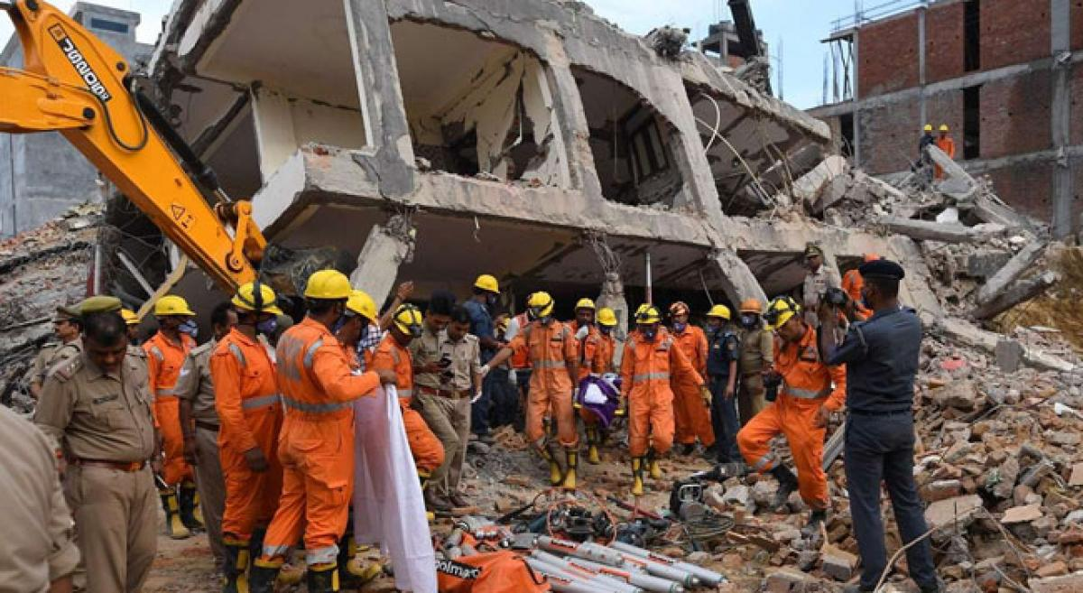
3
PROBLEM DEFINITION
In most natural disaster situations, like hurricanes, earthquakes, fires, there are situations where people get trapped .
Search and rescue operation teams come at play.
This need a lot of specialized manpower and hours
of work to look for possible survivors.
Modular robots proved helpful.
Using robots can minimize the number of personnel and reduce fatigue and errors.
09.MAY.2019
B. Tech, ECE, MACE, Kothamangalam

Slide 4

4
AIM
To design a modular transformable robot
So that it must be :
1) Versatile, flexible and self- reconfigurable.
2) Quick repairable :- easily replaceable parts.
09.MAY.2019
B. Tech, ECE, MACE, Kothamangalam

Slide 5
5
WHAT ARE MBots
“You must be shapeless, formless, like water.
When you pour water in a cup, it becomes the cup.
When you pour water in a bottle, it becomes the bottle.
Become like water my friend.”
Bruce Lee
09.MAY.2019
B. Tech, ECE, MACE, Kothamangalam

Slide 6

6
SOFTWARE STACK
Fusion360
Altium Designer
Arduino
V-REP
09.MAY.2019
B. Tech, ECE, MACE, Kothamangalam

Slide 7
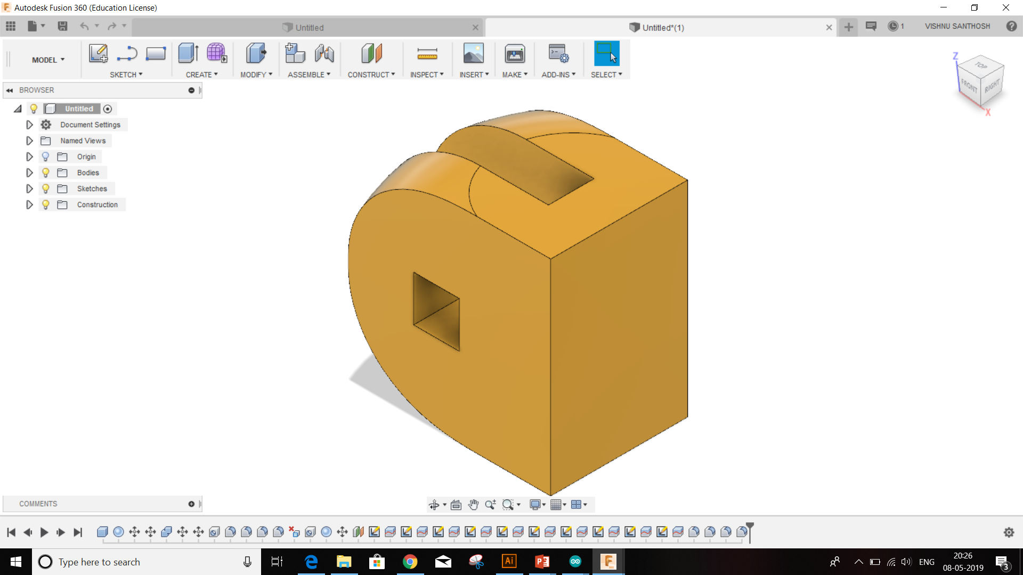
7
FUSION 360
Fusion 360 is an advanced 3D CAD, CAM, and CAE tool.
Help in designing our parts for the modules.
Designed 22 parts for a single module.
09.MAY.2019
B. Tech, ECE, MACE, Kothamangalam

Slide 8
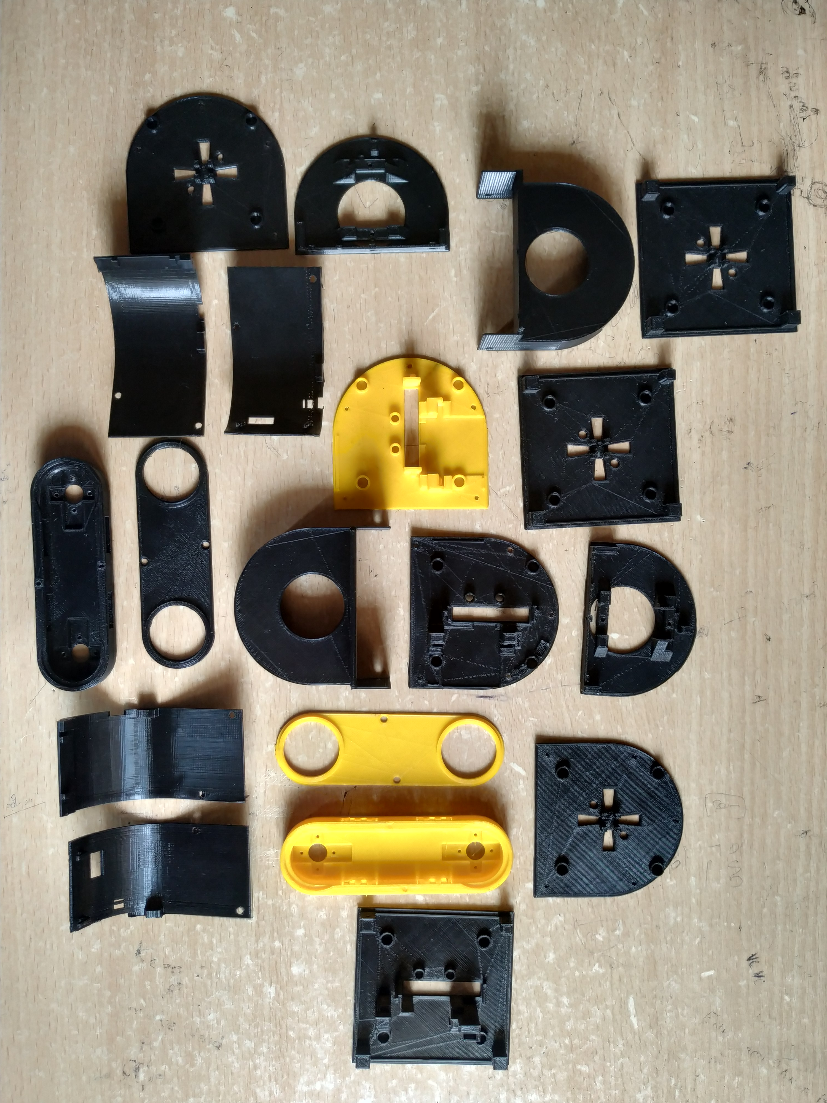
8

Slide 9
VREP
Robotic simulator
Each object/model can be individually controlled via an embedded script.
Script can be written in C/C++, Python, Java, Lua and Mathlab .
Different motions are observed in vrep:
1)Snake motion
2)Hexapod motion
9
09.MAY.2019
B. Tech, ECE, MACE, Kothamangalam

Slide 10
10
HARDWARE REQUIREMENTS
3D printed Parts
ATmega328P
MG92B Servomotor
SG90 Servomotor
Bluetooth HC-05
NRF24L01
Li-Po Battery 3.7V ,600mAh
LM317 voltage regulator
Neodymium Magnets (Disk, 4x3mm)
M1.7x4mm self-tapper screws
Resistors
09.MAY.2019
B. Tech, ECE, MACE, Kothamangalam

Slide 11
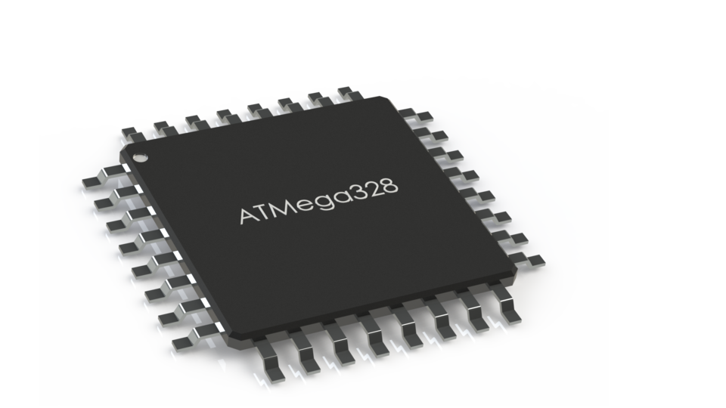
11
ATMEGA 328P
CPU type: 8-bit AVR
Performance: 20 MIPS at 20 MHz[2]
Flash memory: 32 kB
SRAM: 2 kB
EEPROM: 1 kB
Pin count : 28 or 32 pin
Maximum operating frequency: 20 MHz
Maximum I/O pins: 23
External interrupts: 2
09.MAY.2019
B. Tech, ECE, MACE, Kothamangalam

Slide 12
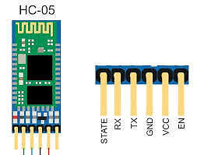
12
HC-05 BLUETOOTH MODULE
HC‐05 module is an easy to use Bluetooth SPP (Serial Port Protocol) module , designed for transparent wireless serial connection setup.
The HC-05 Bluetooth Module can be used in a Master or Slave configuration.
PINS:
Enable
VCC&GND
TXD&RXD
STATE
09.MAY.2019
B. Tech, ECE, MACE, Kothamangalam

Slide 13
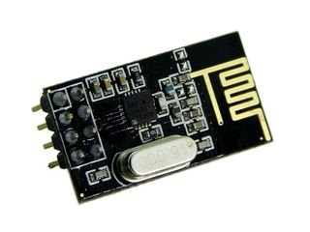
13
NRF24L01
nRF24L01 is a single-chip radio transceiver
2.4-2.5 GHz ISM band.
Transmission speed is from 250kbps to 10 Mbps.
Can get a range upto 100m.
09.MAY.2019
B. Tech, ECE, MACE, Kothamangalam

Slide 14
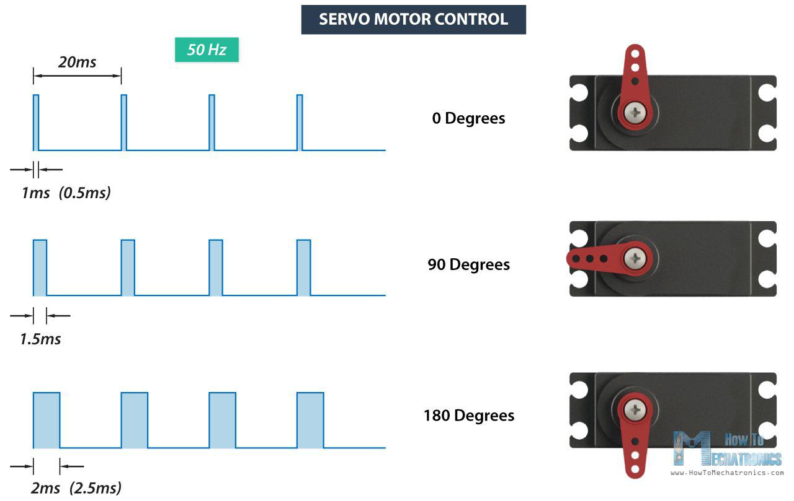
SERVO MOTOR
14
09.MAY.2019
B. Tech, ECE, MACE, Kothamangalam

Slide 15
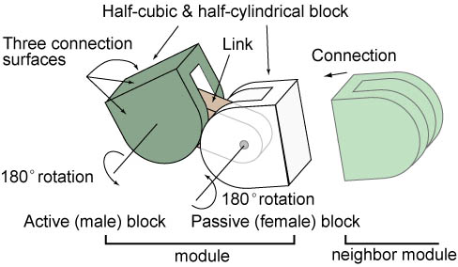
15
How Mbots works
Proposed design
09.MAY.2019
B. Tech, ECE, MACE, Kothamangalam

Slide 16
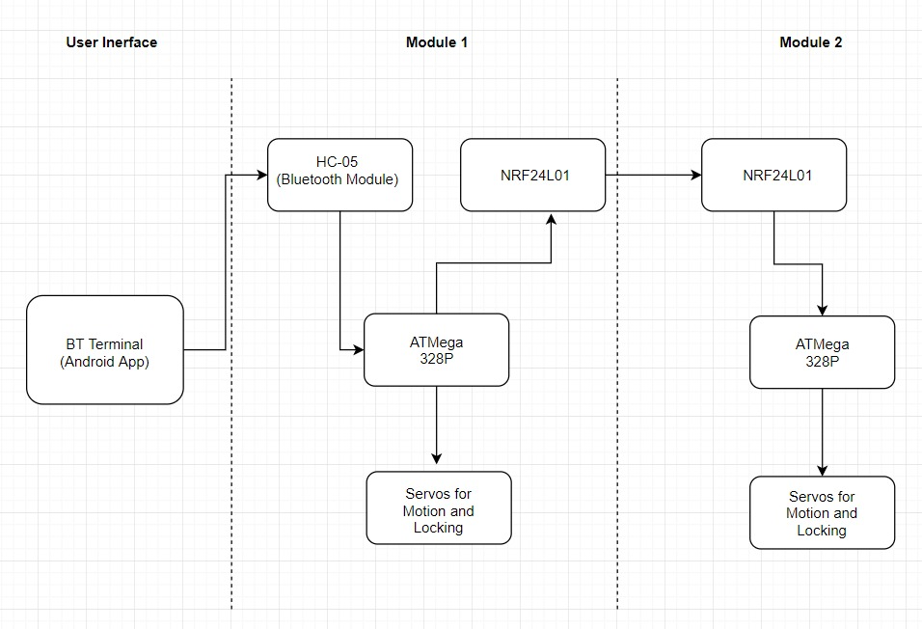
BLOCK DIAGRAM
16
09.MAY.2019
B. Tech, ECE, MACE, Kothamangalam

Slide 17
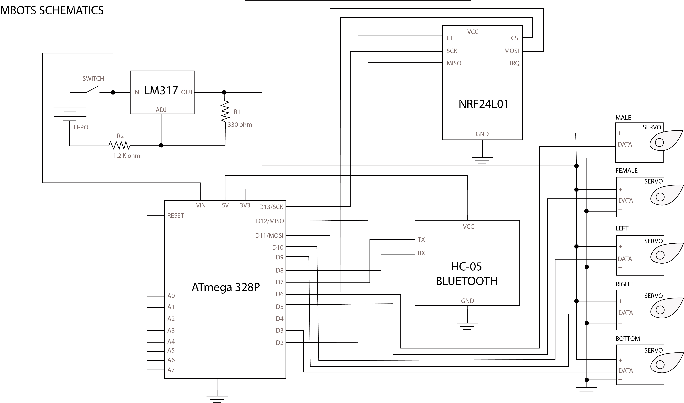
SCHEMATICS
17
09.MAY.2019
B. Tech, ECE, MACE, Kothamangalam

Slide 18
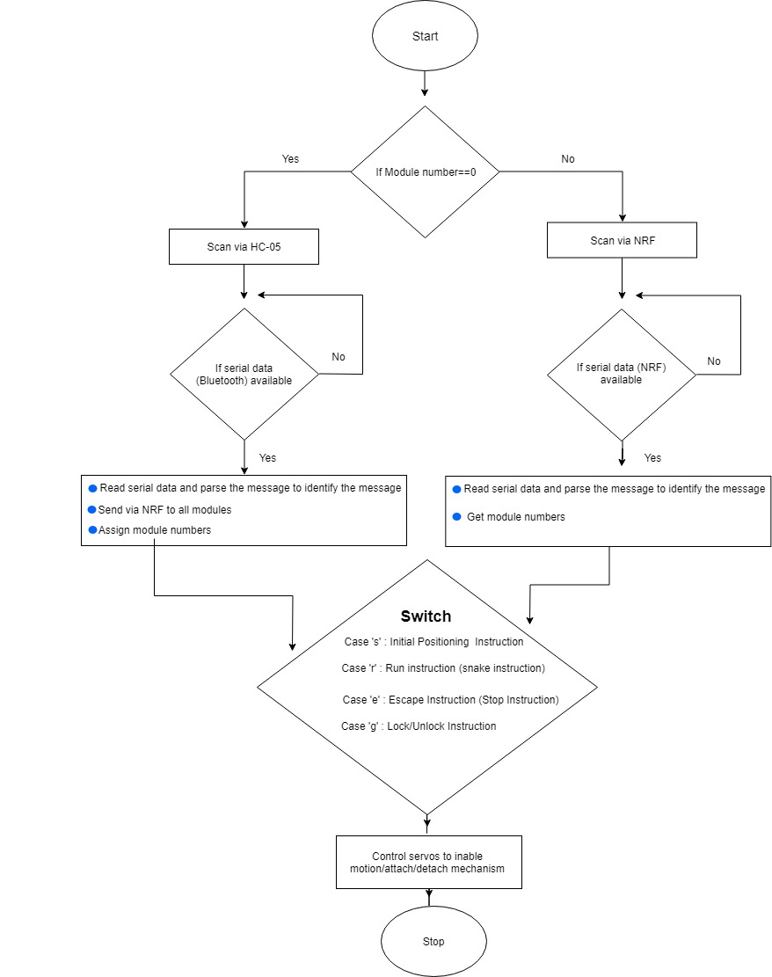
CODE FLOW CHART
18
09.MAY.2019

Slide 19
19
PROBLEMS FACED
NRF24L01 powering up issue due to clone materials available in the market.
Character conveying issues to control the modules.
3D printed parts imperfections.
Packing up of modules due to lack of proper screws .
09.MAY.2019
B. Tech, ECE, MACE, Kothamangalam

Slide 20
20
APPLICATIONS
MBOTS has been designed for the purpose of:
Rescuing people
Surveillance and Security
used in mining accidents
urban disasters
hostage situations
explosions
It can access unreachable areas
It is being made with abilities such as searching, mapping, removing or shoring up rubble, delivery
09.MAY.2019
B. Tech, ECE, MACE, Kothamangalam

Slide 21
21
ADVANTAGES
Small and self-contained robot
Fully 3D printable
Bluetooth + Radio communication
Multiple locomotion modes (snake, wheel, walker...)
Rechargeable batteries
Cheap modules
09.MAY.2019
B. Tech, ECE, MACE, Kothamangalam

Slide 22
22
DISADVANTAGES
Require high quality 3D printers for smooth motion .
Tough packaging due to smaller size.
09.MAY.2019
B. Tech, ECE, MACE, Kothamangalam

Slide 23
23
CONCLUSION
The idea of modular robots is that they can adopt any shape they want, by changing the position and the connection of their modules
The mechanism was able to hold the modules together, but also separate them when needed
The small size, the versatility and the limitless shapes it can adopt, make MBOT the perfect robot for all kind of search and rescue operations
09.MAY.2019
B. Tech, ECE, MACE, Kothamangalam

Slide 24
FUTURE SCOPE
The robot is designed to contain almost all the electronics and motors in one half, so that there is a large free space in the other half
As in future we plan to use that free space to install:
install a thermal camera
microphone and speakers
multiple sensors
more actuators (like grippers) or even more batteries
.
24
09.MAY.2019
B. Tech, ECE, MACE, Kothamangalam

Slide 25
THANK YOU

